Slide 1
CS 106A, Lecture 28 Final Exam Review 2

Slide 2
Plan for today
Announcements
HashMaps
Classes
Inheritance
Interactors
Closing Remarks

Slide 3
Plan for today
Announcements
HashMaps
Classes
Inheritance
Interactors
Closing Remarks

Slide 4
Announcements
Colin’s OH ending ~10 minutes early today, canceled Wednesday and Thursday
Exam reminders:
Email Annie right away if you need a laptop
Charge laptop fully beforehand
Two practice exams have been posted
Exam file and final syntax reference will be probably be posted Thursday evening

Slide 5
Plan for today
Announcements
HashMaps
Classes
Inheritance
Interactors
Closing Remarks

Slide 6
Review: HashMaps
A variable type that represents a collection of key-value pairs
You access values by key, and all keys are unique
Keys and values can be any type of Object (use wrapper classes to store primitives)
Resizable – can add and remove pairs
Has a variety of methods you can use, including .containsKey, .put, .get, .keySet, etc.

Slide 7
HashMap Examples
Phone book: name -> phone number
Search engine: URL -> webpage
Dictionary: word -> definition
Bank: account # -> balance
Social Network: name -> profile
Counter: text -> # occurrences
And many more…

Slide 8
Review: HashMap Operations
m.put(key, value); Adds a key/value pair to the map.
m.put("Eric", "650-123-4567");
Replaces any previous value for that key.
m.get(key) Returns the value paired with the given key.
String phoneNum = m.get("Jenny"); // "867-5309"
Returns null if the key is not found.
m.remove(key); Removes the given key and its paired value.
m.remove(“Annie”);
Has no effect if the key is not in the map.
key value
"Jenny” → "867-5309"
"Mehran" → "123-4567"
"Marty" → "685-2181"
"Chris” → "947-2176"

Slide 9
Review: HashMap Operations
m.containsKey(key); Returns true if the key is in the map, false otherwise
m.size(); Returns the number of key/value pairs in the map.
To iterate over a map:
for (KeyType key : map.keySet()) {
ValueType value = map.get(key);
// Do something with key and/or value
}

Slide 10
What data structure should I use?
Use an array if…
Order matters for your information
You know how many elements you will store
You need the most efficiency
Use an ArrayList if…
Order matters for your information
You do not know how many elements you will store, or need to resize
You need to use ArrayList methods
Use a HashMap if…
Order doesn’t matter for your information
You need to store an association between two types of information
You do not know how many elements you will store, or need to resize
You need to use HashMap methods

Slide 11
Practice: Anagrams
Write a program to find all anagrams of a word the user types.
Type a word [Enter to quit]: scared
Anagrams of scared:
cadres cedars sacred scared
Assume you are given the following:
A dictionary.txt file containing words in the dictionary
A method private String sortLetters(String s) method that takes a string and returns the string with its characters alphabetically ordered.
How can a HashMap help us solve this problem?

Slide 12
Key Idea: Anagrams
Every word has a sorted form where its letters are arranged into alphabetical order.
"fare" → "aefr"
"fear" → "aefr"
"swell" → "ellsw"
"wells" → "ellsw"
Notice that anagrams have the same sorted form as each other.
Notes:
TPS if time

Slide 13
Anagrams Solution
public void run() {
HashMap<String, ArrayList<String>> anagrams =
createAnagramsMap();
// prompt user for words and look up anagrams in map
String word = readLine("Type a word [Enter to quit]: ");
while (word.length() > 0) {
String sorted = sortLetters(word.toLowerCase());
if (anagrams.containsKey(sorted)) {
println("Anagrams of " + word + ":");
println(anagrams.get(sorted));
} else {
println("No anagrams for " + word + ".");
}
word = readLine("Type a word [Enter to quit]: ");
}
}

Slide 14
Anagrams Solution
public void run() {
HashMap<String, ArrayList<String>> anagrams =
createAnagramsMap();
// prompt user for words and look up anagrams in map
String word = readLine("Type a word [Enter to quit]: ");
while (word.length() > 0) {
String sorted = sortLetters(word.toLowerCase());
if (anagrams.containsKey(sorted)) {
println("Anagrams of " + word + ":");
println(anagrams.get(sorted));
} else {
println("No anagrams for " + word + ".");
}
word = readLine("Type a word [Enter to quit]: ");
}
}

Slide 15
Anagrams Solution
public void run() {
HashMap<String, ArrayList<String>> anagrams =
createAnagramsMap();
// prompt user for words and look up anagrams in map
String word = readLine("Type a word [Enter to quit]: ");
while (word.length() > 0) {
String sorted = sortLetters(word.toLowerCase());
if (anagrams.containsKey(sorted)) {
println("Anagrams of " + word + ":");
println(anagrams.get(sorted));
} else {
println("No anagrams for " + word + ".");
}
word = readLine("Type a word [Enter to quit]: ");
}
}

Slide 16
Anagrams Solution
public void run() {
HashMap<String, ArrayList<String>> anagrams =
createAnagramsMap();
// prompt user for words and look up anagrams in map
String word = readLine("Type a word [Enter to quit]: ");
while (word.length() > 0) {
String sorted = sortLetters(word.toLowerCase());
if (anagrams.containsKey(sorted)) {
println("Anagrams of " + word + ":");
println(anagrams.get(sorted));
} else {
println("No anagrams for " + word + ".");
}
word = readLine("Type a word [Enter to quit]: ");
}
}

Slide 17
Anagrams Solution
public void run() {
HashMap<String, ArrayList<String>> anagrams =
createAnagramsMap();
// prompt user for words and look up anagrams in map
String word = readLine("Type a word [Enter to quit]: ");
while (word.length() > 0) {
String sorted = sortLetters(word.toLowerCase());
if (anagrams.containsKey(sorted)) {
println("Anagrams of " + word + ":");
println(anagrams.get(sorted));
} else {
println("No anagrams for " + word + ".");
}
word = readLine("Type a word [Enter to quit]: ");
}
}

Slide 18
Anagrams Solution
public void run() {
HashMap<String, ArrayList<String>> anagrams =
createAnagramsMap();
// prompt user for words and look up anagrams in map
String word = readLine("Type a word [Enter to quit]: ");
while (word.length() > 0) {
String sorted = sortLetters(word.toLowerCase());
if (anagrams.containsKey(sorted)) {
println("Anagrams of " + word + ":");
println(anagrams.get(sorted));
} else {
println("No anagrams for " + word + ".");
}
word = readLine("Type a word [Enter to quit]: ");
}
}

Slide 19
Anagrams Solution, Part 2
// Returns a new map from a sorted word to all words created
// from those letters - e.g. “acers” -> {“scare”, “cares”,...}
private HashMap<String, ArrayList<String>> createAnagramsMap() {
HashMap<String, ArrayList<String>> anagrams =
new HashMap<>();
try {
Scanner scanner =
new Scanner(new File("res/dictionary.txt"));
while (scanner.hasNext()) {
String word = scanner.next();
String sorted = sortLetters(word);
...

Slide 20
Anagrams Solution, Part 2
// Returns a new map from a sorted word to all words created
// from those letters - e.g. “acers” -> {“scare”, “cares”,...}
private HashMap<String, ArrayList<String>> createAnagramsMap() {
HashMap<String, ArrayList<String>> anagrams =
new HashMap<>();
try {
Scanner scanner =
new Scanner(new File("res/dictionary.txt"));
while (scanner.hasNext()) {
String word = scanner.next();
String sorted = sortLetters(word);
...

Slide 21
Anagrams Solution, Part 2
// Returns a new map from a sorted word to all words created
// from those letters - e.g. “acers” -> {“scare”, “cares”,...}
private HashMap<String, ArrayList<String>> createAnagramsMap() {
HashMap<String, ArrayList<String>> anagrams =
new HashMap<>();
try {
Scanner scanner =
new Scanner(new File("res/dictionary.txt"));
while (scanner.hasNext()) {
String word = scanner.next();
String sorted = sortLetters(word);
...

Slide 22
Anagrams Solution, Part 2
// Returns a new map from a sorted word to all words created
// from those letters - e.g. “acers” -> {“scare”, “cares”,...}
private HashMap<String, ArrayList<String>> createAnagramsMap() {
HashMap<String, ArrayList<String>> anagrams =
new HashMap<>();
try {
Scanner scanner =
new Scanner(new File("res/dictionary.txt"));
while (scanner.hasNext()) {
String word = scanner.next();
String sorted = sortLetters(word);
...

Slide 23
Anagrams Solution, Part 2
// Returns a new map from a sorted word to all words created
// from those letters - e.g. “acers” -> {“scare”, “cares”,...}
private HashMap<String, ArrayList<String>> createAnagramsMap() {
HashMap<String, ArrayList<String>> anagrams =
new HashMap<>();
try {
Scanner scanner =
new Scanner(new File("res/dictionary.txt"));
while (scanner.hasNext()) {
String word = scanner.next();
String sorted = sortLetters(word);
...

Slide 24
Anagrams Solution, Part 2
ArrayList<String> words;
if (anagrams.containsKey(sorted)) {
words = anagrams.get(sorted);
} else {
words = new ArrayList<>();
}
words.add(word);
anagrams.put(sorted, words);
}
scanner.close();
} catch (IOException ex) {
println("Error reading file.");
}
return anagrams;
}

Slide 25
Anagrams Solution, Part 2
ArrayList<String> words;
if (anagrams.containsKey(sorted)) {
words = anagrams.get(sorted);
} else {
words = new ArrayList<>();
}
words.add(word);
anagrams.put(sorted, words);
}
scanner.close();
} catch (IOException ex) {
println("Error reading file.");
}
return anagrams;
}

Slide 26
Anagrams Solution, Part 2
ArrayList<String> words;
if (anagrams.containsKey(sorted)) {
words = anagrams.get(sorted);
} else {
words = new ArrayList<>();
}
words.add(word);
anagrams.put(sorted, words);
}
scanner.close();
} catch (IOException ex) {
println("Error reading file.");
}
return anagrams;
}

Slide 27
Anagrams Solution, Part 2
ArrayList<String> words;
if (anagrams.containsKey(sorted)) {
words = anagrams.get(sorted);
} else {
words = new ArrayList<>();
}
words.add(word);
anagrams.put(sorted, words);
}
scanner.close();
} catch (IOException ex) {
println("Error reading file.");
}
return anagrams;
}

Slide 28
Anagrams Solution, Part 2
ArrayList<String> words;
if (anagrams.containsKey(sorted)) {
words = anagrams.get(sorted);
} else {
words = new ArrayList<>();
}
words.add(word);
anagrams.put(sorted, words);
}
scanner.close();
} catch (IOException ex) {
println("Error reading file.");
}
return anagrams;
}

Slide 29
Plan for today
Announcements
HashMaps
Classes
Inheritance
Interactors
Closing Remarks

Slide 30
What Is A Class?
A class defines a new variable type.

Slide 31


Classes Are Like Blueprints
iPod blueprint (class)
state: current song volume battery life
behavior: power on/off change station/song change volume choose random song
constructs
iPod (variable) #1
state: song = "1,000,000 Miles" volume = 17 battery life = 2.5 hrs
behavior: power on/off change station/song change volume choose random song
iPod (variable) #2
state: song = "Letting You" volume = 9 battery life = 3.41 hrs
behavior: power on/off change station/song change volume choose random song
iPod (variable) #3
state: song = "Discipline" volume = 24 battery life = 1.8 hrs
behavior: power on/off change station/song change volume choose random song

Slide 32
Creating A New Class
What information is inside this new variable type?
These are its instance variables.
How do you create a variable of this type?
This is the constructor.
What can this new variable type do?
These are its public methods.

Slide 33
Using Constructors
ba1
BankAccount ba1 =
new BankAccount("Marty", 1.25);
BankAccount ba2 =
new BankAccount("Mehran", 900000.00);
When you call a constructor (with new):
Java creates a new object of that class.
The constructor runs on that new object.
The newly created object is returned wherever constructor was called.
name = "Marty"
balance = 1.25
BankAccount(nm, bal) {
name = nm;
balance = bal;
}
ba2
name = "Mehran"
balance = 900000.00
BankAccount(nm, bal) {
name = nm;
balance = bal;
}

Slide 34
Example: BankAccount
public class BankAccount {
// Step 1: the data inside a BankAccount
private String name;
private double balance;
// Step 2: how to create a BankAccount
public BankAccount(String accountName, double startBalance) {
name = accountName;
balance = startBalance;
}
public BankAccount(String accountName) {
name = accountName;
balance = 0;
}
}
Notes:
Methods are public so other files can access them

Slide 35
Defining Methods In Classes
ba1
Methods defined in classes can be called
on an instance of that class.
When one of these methods executes,
it can reference that object’s copy of
instance variables.
ba1.deposit(0.20);
ba2.deposit(1000.00);
This means calling one of these methods on different objects will give
different results, reached via the same process.
name = "Marty"
balance = 1.45
deposit(amount) {
balance += amount;
}
ba2
name = "Mehran"
balance = 901000.00
deposit(amount) {
balance += amount;
}

Slide 36
Example: BankAccount
public class BankAccount {
// Step 1: the data inside a BankAccount
private String name;
private double balance;
// Step 2: how to create a BankAccount (omitted)
// Step 3: the things a BankAccount can do
public void deposit(double amount) {
balance += amount;
}
public boolean withdraw(double amount) {
if (balance >= amount) {
balance -= amount;
return true;
}
return false;
}
}
Notes:
Methods are public so other files can access them

Slide 37
Practice: Airplane!
Let’s write a class called Airplane that implements functionality for boarding/unboarding passengers from a plane.
Airplane plane = new Airplane(100);
while (!plane.isFull()) {
String passengerName = readLine("Name: ");
boolean priority = readBoolean("Priority? ");
plane.boardPassenger(passengerName, priority);
}
// fly...
while (!plane.isEmpty()) {
String passengerName = plane.unboardPassenger();
println("Unboarded " + passengerName);
}

Slide 38
Practice: Airplane!
Let’s write a class called Airplane that implements functionality for boarding/unboarding passengers from a plane.
It should implement the following methods:
// Constructor should take 1 parameter (plane capacity)
/** Boards 1 passenger, at front or back **/
public void boardPassenger(String name, boolean priority);
public boolean isFull();
public boolean isEmpty();
/** Unboards and returns next passenger **/
public String unboardPassenger();

Slide 39
Creating A New Class
What information is inside this new variable type?
These are its instance variables.
How do you create a variable of this type?
This is the constructor.
What can this new variable type do?
These are its public methods.

Slide 40
Practice: Airplane!
public class Airplane {
private ArrayList<String> passengers;
private int capacity;
...

Slide 41
Creating A New Class
What information is inside this new variable type?
These are its instance variables.
How do you create a variable of this type?
This is the constructor.
What can this new variable type do?
These are its public methods.

Slide 42
Practice: Airplane!
// Private instance variables
private ArrayList<String> passengers;
private int capacity;
public Airplane(int numSeats) {
capacity = numSeats;
passengers = new ArrayList<>();
}
...

Slide 43
Creating A New Class
What information is inside this new variable type?
These are its instance variables.
How do you create a variable of this type?
This is the constructor.
What can this new variable type do?
These are its public methods.

Slide 44
boardPassenger
...
public void boardPassenger(String name, boolean priority) {
if (!isFull()) {
if (priority) { passengers.add(0, name);
} else {
passengers.add(name);
}
}
}
...

Slide 45
isFull
...
public boolean isFull() {
return capacity == passengers.size();
}
...

Slide 46
isEmpty
...
public boolean isEmpty() {
return passengers.isEmpty();
}
...

Slide 47
unboardPassenger
...
public String unboardPassenger() {
if (!isEmpty()) {
return passengers.remove(0);
}
return null;
}
...

Slide 48
Plan for today
Announcements
HashMaps
Classes
Inheritance
Interactors
Closing Remarks

Slide 49
Review: Inheritance
Inheritance lets us relate our variable types to one another.

Slide 50
Using Inheritance
public class Name extends Superclass {
Example:
public class Programmer extends Employee {
...
}
By extending Employee, this tells Java that Programmer can do everything an Employee can do, plus more.
Programmer automatically inherits all of the code from Employee!
The superclass is Employee, the subclass is Programmer.

Slide 51
Inheritance
Variable types can seem to “inherit” from one other. We don’t want to have to duplicate code for each one!
Employee
Programmer
Karel Programmer

Slide 52
Extending GCanvas
Sometimes, we want to be able to have all of our graphics-related code in a separate file.
To do this, instead of using the provided GraphicsProgram canvas, we define our own subclass of GCanvas, have our program extend Program, and add our own canvas ourselves.
Then, all graphics-related code can go in our GCanvas subclass.

Slide 53
Example: Programmer
public class Programmer extends Employee {
private int timeCoding;
...
public void code() { timeCoding += 10;
}
}
...
Programmer annie = new Programmer(“Annie”);
annie.code(); // from Programmer
annie.promote(); // from Employee!
Notes:
If you add functionality to Employee it adds everywhere

Slide 54
Example: KarelProgrammer
public class KarelProgrammer extends Programmer {
private int numBeepersPicked;
...
public void pickBeepers() { numBeepersPicked += 2;
}
}
...
KarelProgrammer colin = new KarelProgrammer(“Colin”);
colin.pickBeepers(); // from KarelProgrammer
colin.code(); // from Programmer!
colin.promote(); // From Employee!

Slide 55
Extending GCanvas
public class MyCanvas extends GCanvas {
public void addCenteredSquare(int size) {
GRect rect = new GRect(size, size);
int x = getWidth() / 2.0 –
rect.getWidth() / 2.0;
int y = getHeight() / 2.0 –
rect.getHeight() / 2.0;
add(rect, x, y);
}
}

Slide 56
Extending GCanvas
public class Graphics extends Program {
public void run() { // We have to make our own GCanvas now
MyCanvas canvas = new MyCanvas();
add(canvas);
canvas.addCenteredSquare(20);
}
}

Slide 57
Plan for today
Announcements
HashMaps
Classes
Inheritance
Interactors
Closing Remarks

Slide 58
Review: Interactors
Add interactors in init()
addActionListeners() to listen for button presses
.addActionListener(this) on text fields for ENTER
Plus (usually) setActionCommand(command)
Implement actionPerformed
Java will call actionPerformed whenever an action event occurs.

Slide 59
Interactors
public void actionPerformed(ActionEvent e) {
if (e.getActionCommand().equals(”My Interactor”)) {
...
}
}
// ... equivalent to ...
public void actionPerformed(ActionEvent e) {
if (e.getSource() == myInteractor) {
...
}
}

Slide 60
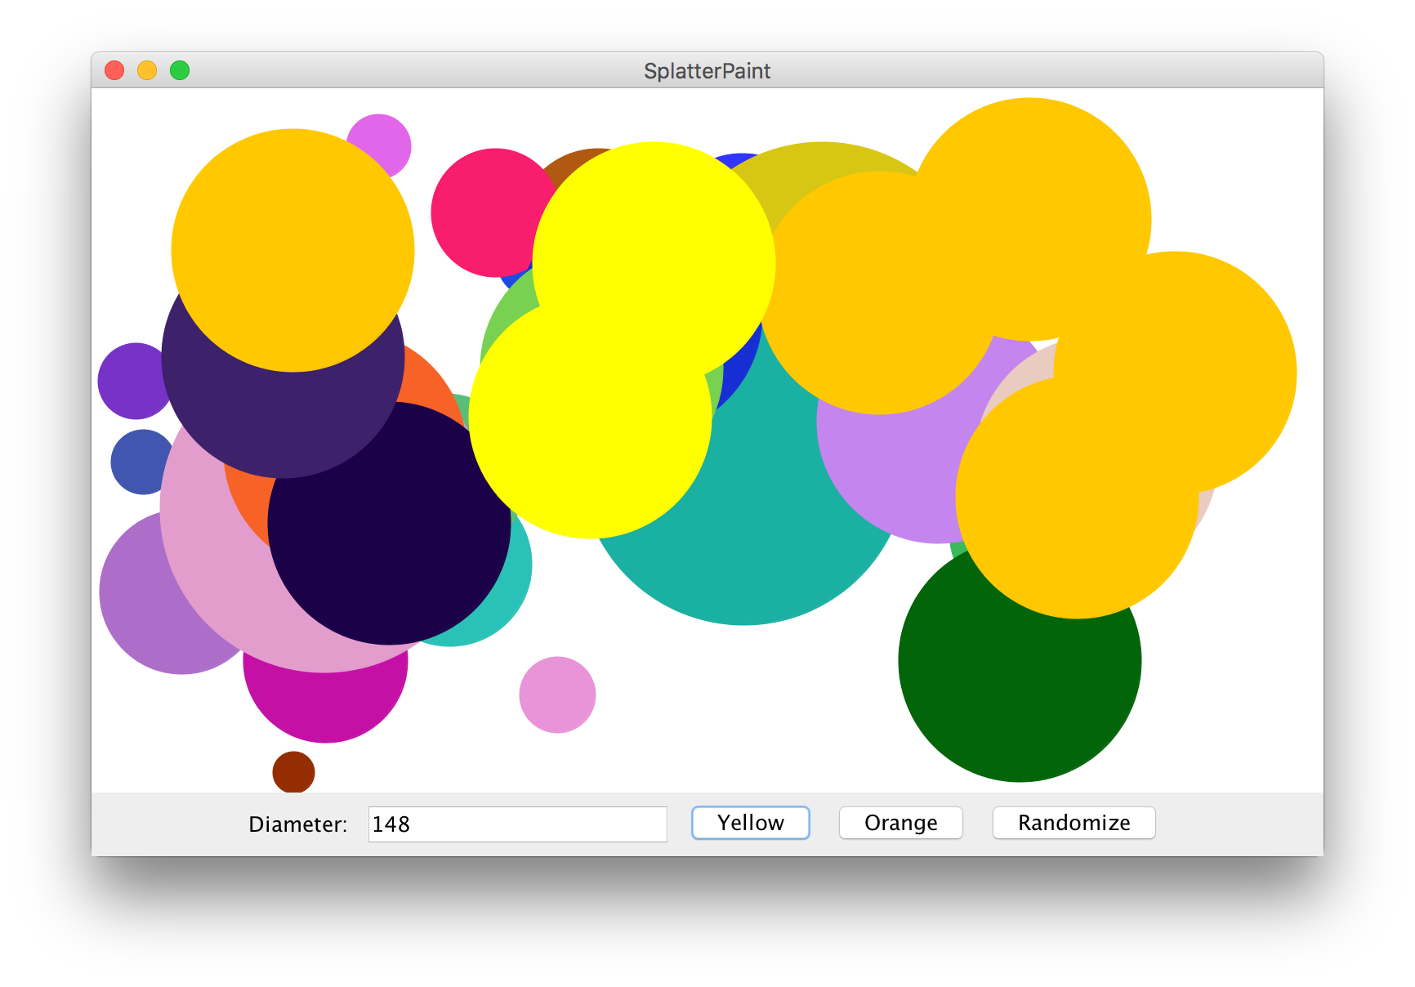
Practice: SplatterPaint

Slide 61
Practice: SplatterPaint
Add a new “splatter” (GOval) every time the user clicks on the “Yellow” or “Orange” buttons.
If the user presses “ENTER” in the text field, add a yellow splatter.
The splatter’s diameter should be what is entered in the text box (assume it’s valid), and placed randomly entirely onscreen.
If the user clicks “Randomize”, all onscreen splatters should be changed to different random colors.
How would we implement this? How should we design our custom GCanvas class?

Slide 62
Solution: SplatterPaint
Have a SplatterPaint class that extends Program, to which we add our custom GCanvas.
Have a SplatterPaintCanvas class that extends GCanvas, which contains all graphics logic. It could have public methods such as:
public void addSplatter(int diameter, Color color) Adds a splatter with the given diameter and color randomly onscreen
public void randomizeColors() Randomizes the colors of all onscreen splatters.

Slide 63
SplatterPaint.java
public class SplatterPaint extends Program {
// The width of the diameter text field (in chars)
private static final int DIAMETER_FIELD_WIDTH = 15;
// The field for entering the splatter diameter
private JTextField diameterField;
// The custom canvas that displays all splatters
private SplatterPaintCanvas canvas;
...
}

Slide 64
SplatterPaint.java
public void init() {
canvas = new SplatterPaintCanvas();
add(canvas);
// Add the text field
add(new JLabel("Diameter: "), SOUTH);
diameterField = new JTextField(DIAMETER_FIELD_WIDTH);
diameterField.setActionCommand("Yellow");
diameterField.addActionListener(this);
add(diameterField, SOUTH);
// Add the buttons
add(new JButton("Yellow"), SOUTH);
add(new JButton("Orange"), SOUTH);
add(new JButton("Randomize"), SOUTH);
addActionListeners();
}

Slide 65
SplatterPaint.java
public void actionPerformed(ActionEvent e) {
if (e.getActionCommand().equals("Yellow")) {
// Add a yellow circle
int diameter =
Integer.parseInt(diameterField.getText());
canvas.addSplatter(diameter, Color.yellow);
} else if (e.getActionCommand().equals("Orange")) {
// Add an orange circle
int diameter =
Integer.parseInt(diameterField.getText());
canvas.addSplatter(diameter, Color.orange);
} else if (e.getActionCommand().equals("Randomize")) {
// Randomize all existing splatters
canvas.randomizeColors();
}
}

Slide 66
SplatterPaintCanvas.java
public class SplatterPaintCanvas extends GCanvas {
ArrayList<GOval> splatters;
public SplatterPaintCanvas() {
splatters = new ArrayList<>();
}
...
}

Slide 67
SplatterPaintCanvas.java
public void addSplatter(int diameter, Color color) {
int x = RandomGenerator.getInstance()
.nextInt(0, getWidth() - diameter);
int y = RandomGenerator.getInstance()
.nextInt(0, getHeight() - diameter);
GOval splatter = new GOval(x, y, diameter, diameter);
splatter.setFilled(true);
splatter.setColor(color);
add(splatter);
splatters.add(splatter);
}

Slide 68
SplatterPaintCanvas.java
public void randomizeColors() {
for (GOval splatter : splatters) {
Color newColor =
RandomGenerator.getInstance().nextColor();
splatter.setColor(newColor);
}
}

Slide 69
Plan for today
Announcements
HashMaps
Classes
Inheritance
Interactors
Closing Remarks

Slide 70


First Day
3
+
+
+
+
2
+
+
+
+
1
+
+
+
+
1
2
3
4

Slide 71
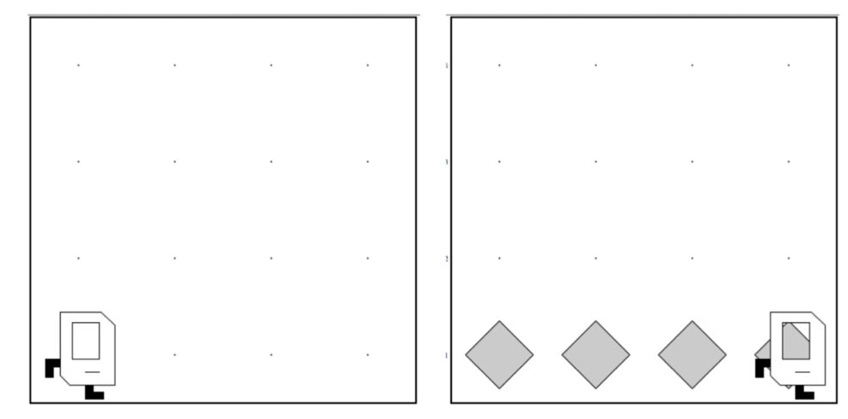
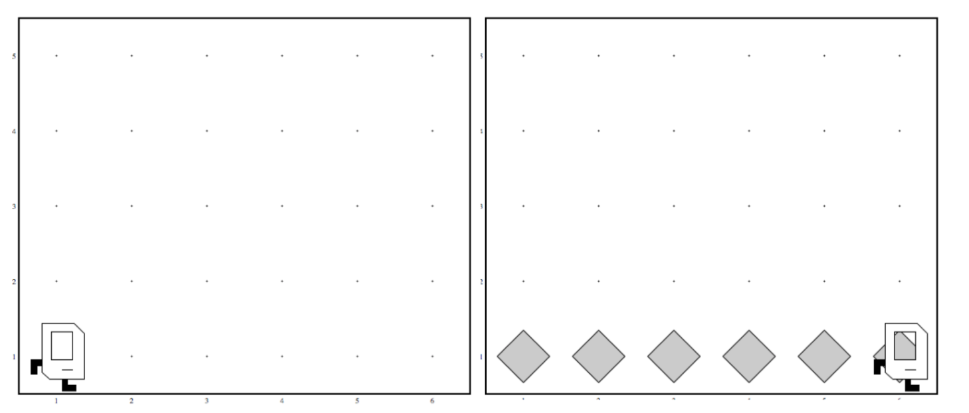
Generalization
Before
After

Slide 72

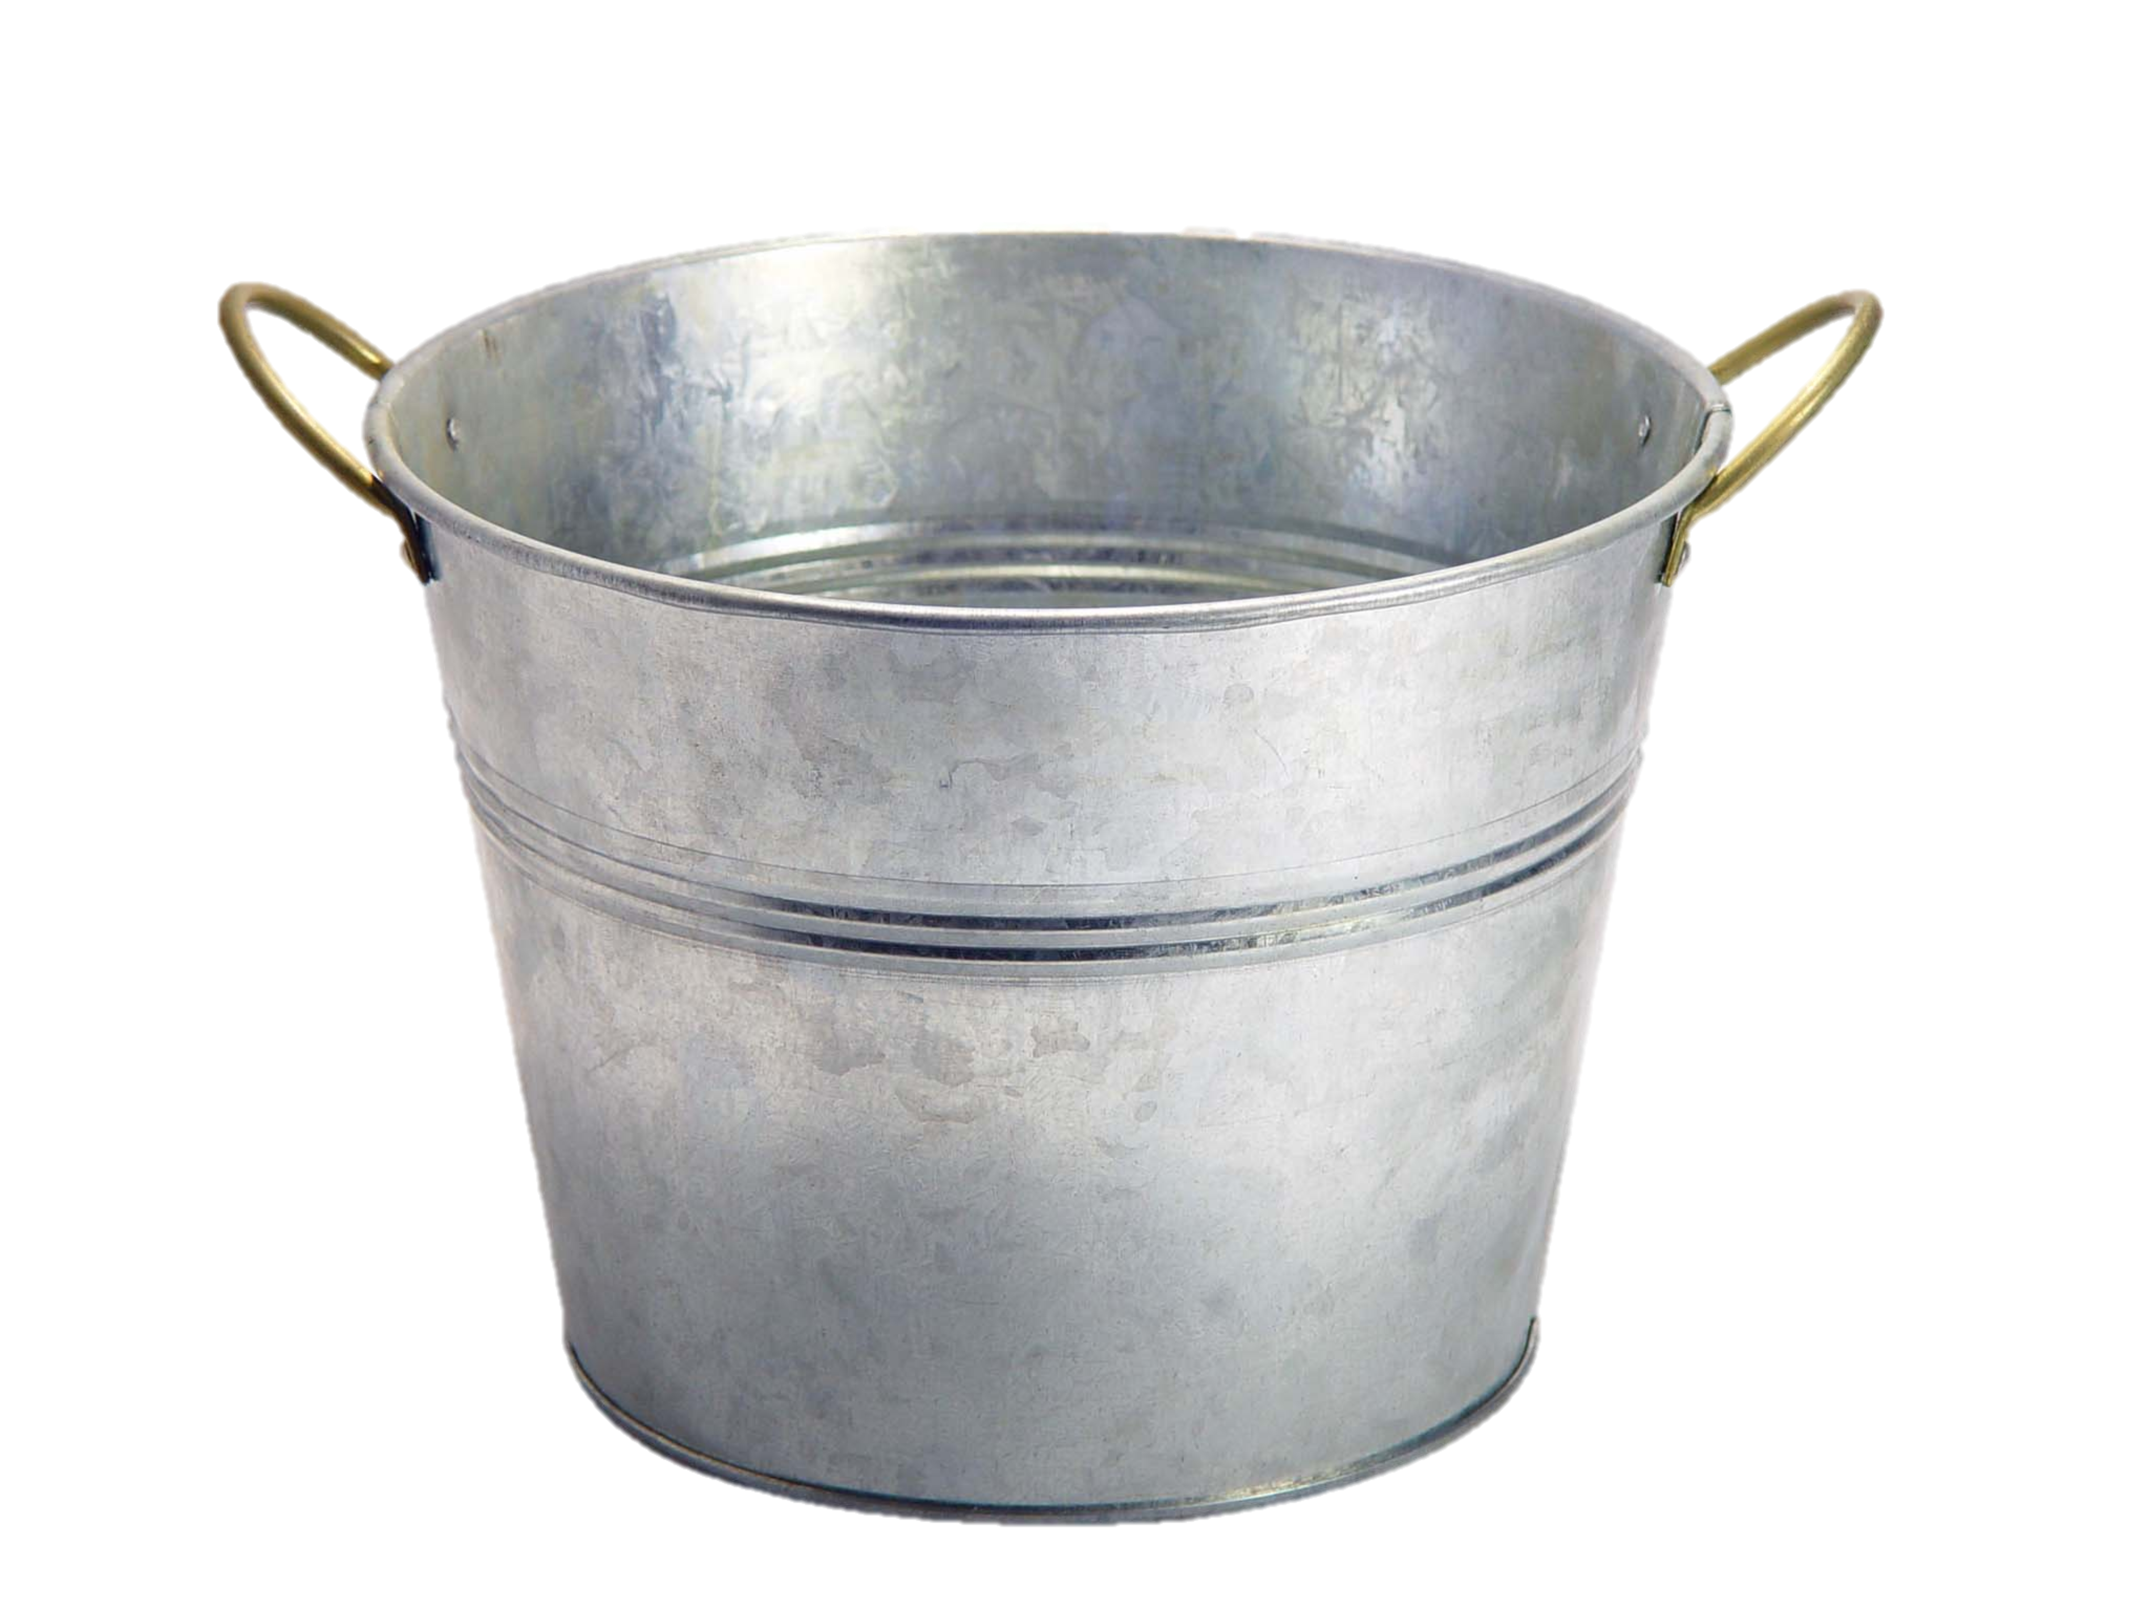
Variables Are Like Boxes!

Slide 73



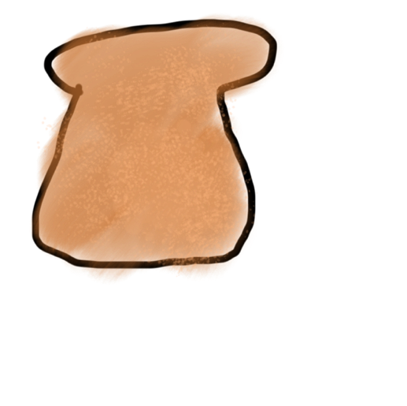
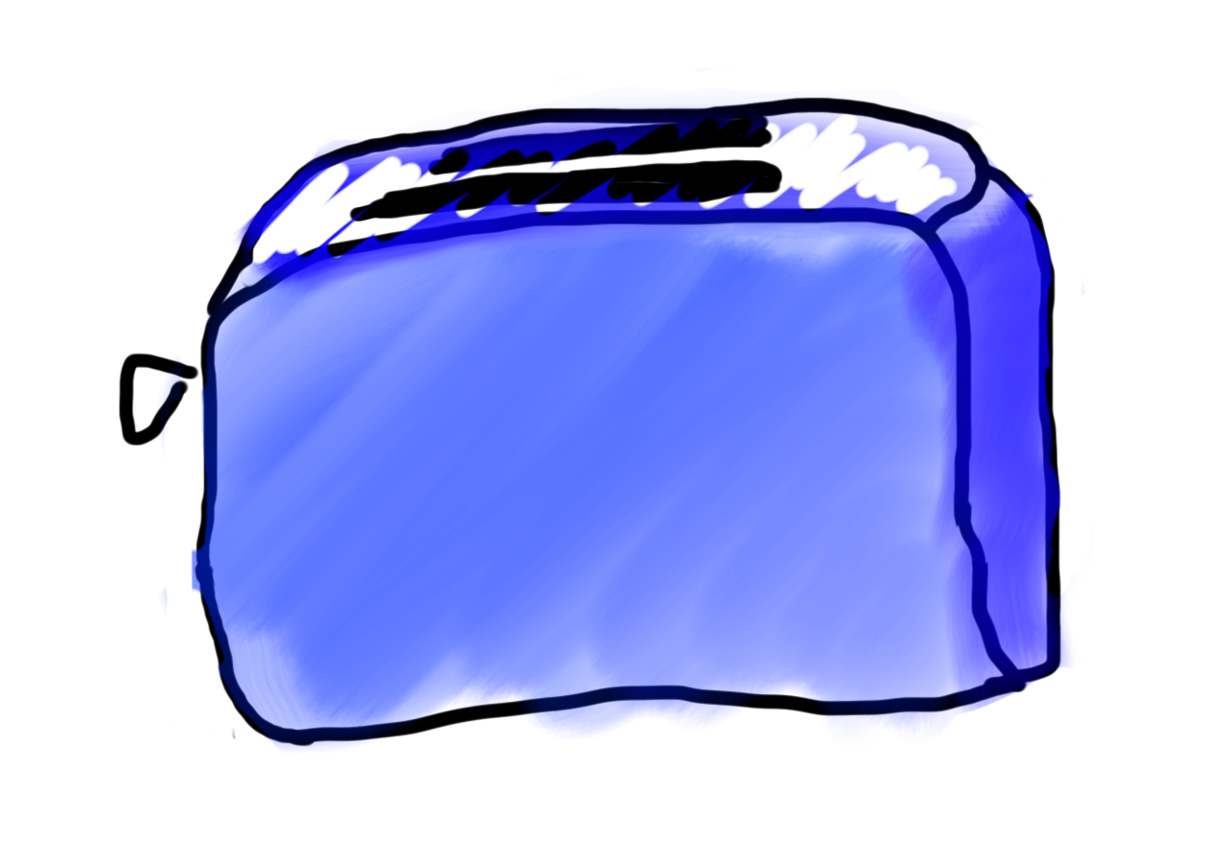
Methods Are Like Toasters!
parameter(s)
return

Slide 74

A Variable Love Story

Slide 75
A Variable Love Story
origin

Slide 76

Matrices

Slide 77
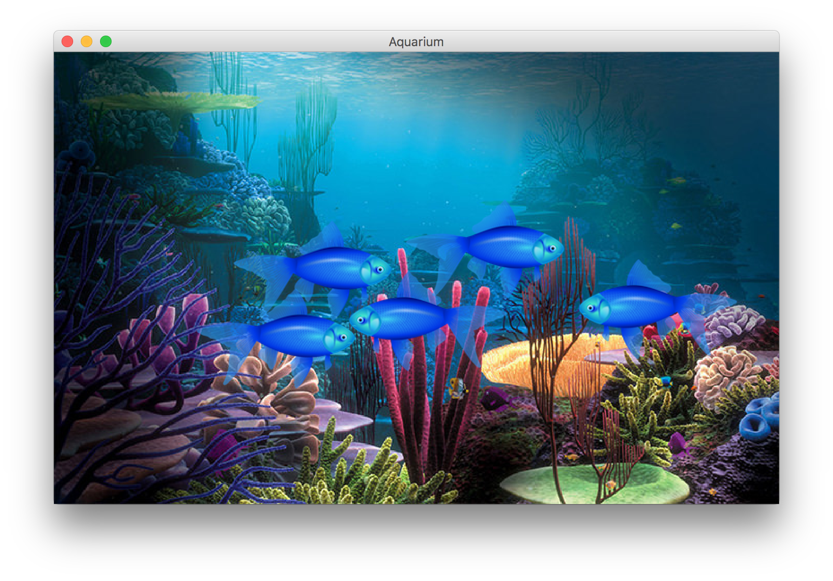
Graphics, Animation, Classes!

Slide 78
Anyone can be a computer scientist.

Slide 79
Anyone can use computer science without being a computer scientist.
Notes:
You can be a software engineer, a physics researcher writing simulations, a teacher making websites for students to use, a journalist analyzing data for an article, an activist making apps to help people mobilize for protests

Slide 80
Computer science is using computing to solve problems.

Slide 81
Anyone is welcome to study computer science.

Slide 82
We hope 106A excited you to use the CS you know and to learn more!

